Slide 1




Project CLIMB: Capturing Language IMmersion Benefits
What is Project CLIMB?
Project CLIMB is a partnership between high-quality Dual Language Immersion schools and university researchers.
The project’s major goal is to increase awareness and understanding of the benefits of bilingualism for children’s brain development – especially its impact on their executive function (EF) skills.
Our team will also document the key features of Language Immersion programs that spur executive function, and success in biliteracy.

Slide 2

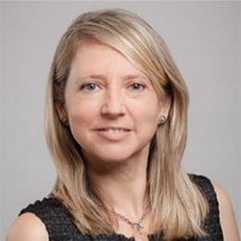
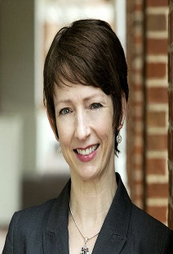
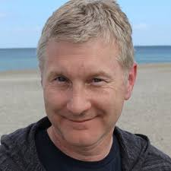
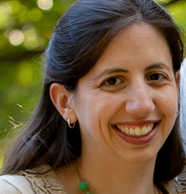
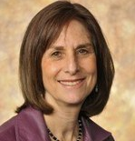
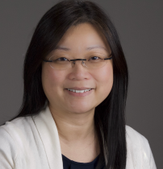
Who We Are
Ana Taboada Barber, Ph.D.
University of Maryland
Kelly B. Cartwright, Ph.D.
Christopher Newport University
Gregory R. Hancock, Ph.D.
University of Maryland
Susan Lutz Klauda, Ph.D.
University of Maryland
Ellen Bialystok, Ph.D.
York University
Gigi Luk, Ph.D.
McGill University

Slide 3

Executive Function Skills Foster
Academic Success
According to teachers, EFs are the greatest enabler of classroom success.
Attention skills, the capacity to hold information in working memory, and the ability to inhibit impulses are all key predictors of literacy and math achievement from Grades K-5.
(Jacob & Parkinson, 2015; McClelland et al., 2007)
What are Executive Function Skills?
Executive function (EF) skills are cognitive skills that we use to manage our activities as we work toward goals.
EFs involve things like maintaining and shifting attention, holding information in mind while we work with part of it, inhibiting impulsive responses, and shifting flexibly within and across tasks.
EF skills are associated with important brain developments in the frontal lobe across childhood and are critical for accomplishing goal-directed tasks – like the school assignments children must complete every day.

Slide 4
Bilingualism and Brain Development
Neural networks are malleable – experiences drive brain development.
The experience of learning two languages reorganizes the brain in ways that support the development of executive function skills.
(Adesope et al., 2010; Casey et al., 2005; Serpell & Esposito, 2016)
Insights from Project CLIMB may help educators capitalize on the brain’s malleability by designing instruction that targets students’ executive function development
We can learn more about HOW bilingualism supports EF skills and academic learning…
The economic, social, and cultural benefits of proficiency in multiple languages are well-known.
(Geisler, 2012; Zwerdling, 2012; Commission on Language Learning, 2017)
Research has also found that bilingual adults and children have stronger EF skills than monolinguals.
Little is known, however, about bilingualism’s benefits for executive function in elementary children learning Spanish and English.
Project CLlMB addresses this gap.

Slide 5

Project CLIMB is…
Scientifically-Grounded
  Aligned with 20+ years of research on bilingualism and DLI instruction
  Research team with diverse areas of expertise in psychology and education
Significant
  Developmental portrait (Grades K-5)
  Emphasis on understudied benefits of bilingualism
  Identification of critical instructional practices for bilitearcy in Grades K-5
Straightforward
What we need from schools:
  Students participate in study tasks once per year for 3 years
  All tasks administered by UMD staff
  3-4 observations per year in select classrooms
  Parents asked to complete one questionnaire
Benefits of Joining
Project CLIMB
Partner with university faculty in sharing findings with practitioner and academic audiences
Become a flagship school for showcasing Language Immersion and biliteracy benefits
Receive Professional Development opportunities aligned with current district/school priorities and initiatives
Obtain data that helps your school and district track growth in EF skills and biliteracy

Slide 6
Study Design
 | Year 1 2021-2022 | Year 2 2022-2023 | Year 3 2023-2024
Kindergarten | X
Grade 1 | X | X
Grade 2 | X | X | X
Grade 3 | X | X | X
Grade 4 | X | X | X
Grade 5 |  | X | X
Each color represents a different cohort.

Slide 7
Project Timeline
Year 1 2021-2022 | Year 2 2022-2023 | Year 3 2023-2024 | Year 4 2024-2025
Meet with school personnel to describe the project and agree on participation and partnership Send home parent consent forms and questionnaire Conduct Yr 1 assessments and class observations in grades K-4 | Conduct Yr 2 assessments and class observations in grades 1-5 Share Yr 1 data with school staff Provide Literacy Professional Development, as/if requested | Conduct Yr 3 assessments and class observations in grades 2-5 Share Yrs 1& 2 data with school staff Provide Literacy Professional Development, as/if requested | Conduct final data analyses (i.e., no data collection is schools will take place this year, unless requested by school or district) Share findings with the school first, and then the district

Slide 8
Study Assessments
Variable category | Variable | Assessment name | Maximum Length in minutes
Cognitive | Executive function | Frog Matrices | 10
Cognitive | Executive function | Dog-Bone Trail-making | 10
Cognitive | Executive function | N-Back | 7
Reading | Reading comprehension | Woodcock Johnson/Woodcock Munoz Passage Comprehension | 10 (5 per language)
Language | Expressive vocabulary | Woodcock Johnson/Woodcock Munoz Vocabulary | 10 (5 per language)
Language | Word knowledge | Verbal Fluency - Category | 6 (3 per language)
Language | Metalinguistic awareness | Verbal Fluency - Letter | 6 (3 per language)

Slide 9

Examples from EF and Literacy Tasks
Photo credit: US Department of Education via flickr (CC BY 2.0)

Slide 10
Executive Function:
Frog Matrices
Notes:
Purpose: This computerized task assesses visuospatial working memory, including the ability to
manipulate information in working memory, and inhibition (specifically, the ability to suppress
interference).
What students will be asked to do: Students will be asked to remember the locations of frogs presented
on-screen in a 3 x 3 matrix; each cell represents a pond where a frog could be resting. Each trial includes
three stages: presentation of the to-be-remembered items, a blank screen display for 2000 ms, and a
blank matrix on which children respond by touching the ponds where a frog appeared in the first stage.
Each trial entails remembering the location of 2-6 frogs, presented either simultaneously or
sequentially; the number to be remembered increases gradually within each condition.
Number of trials or items: There will be 20 trials, 5 for each of four conditions. The four conditions,
which vary in the demands on working memory and attention control, are presented on the next page.
The conditions are (I) simple span (all frogs presented simultaneously in Stage 1) (II) masked (the blank
screen in Stage 2 is replaced with a distractor matrix displaying three frogs in a different set of ponds
than in Stage 1; in Stage 3, children must recall the from locations from Stage 1), (III) sequential (in Stage
1, the frogs appear for 1 s each, one after the other; in Stage 3, children must respond with the correct
locations, in order of presentation), (IV) operational (in Stage 1, the frogs are again presented
sequentially, but this time children must respond in Stage 3 by following a given path on the screen, only
pressing on the ponds where a frog had been located; that is, they must re-order the original sequence
in which they had been presented while remembering all their locations).
Administration time, including directions: maximum of 12 minutes

Slide 11
Executive Function:
Frog Matrices (cont.)

Slide 12
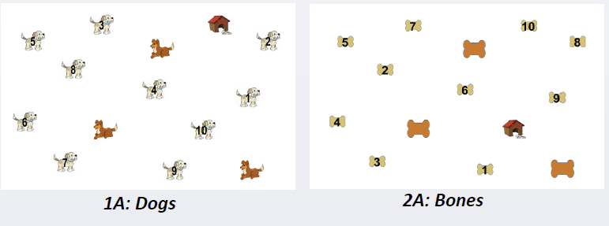
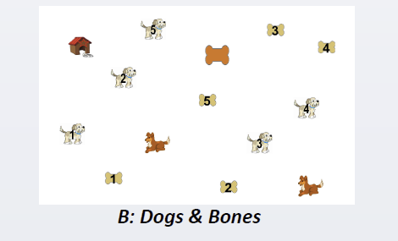
Executive Function:
Dog-Bone Trail-Making Task
Notes:
In general, trail making tasks assess attention and switching/flexibility. They are like connect-the-dot tasks
This version was created for kids with diverse language backgrounds who may not have
Automatized the English alphabetic sequence (in typical/adult version, part B would entail switching between numbers and letters while connecting-the-dots – ie., 1-A-2-B-3-C…etc
So, in 1A and 2a, kids connect the dogs or bones in numerical order, as quickly as possible
In B, they match dogs and bones by number – i.e., dog1-bone1-dog2-bone2-etc.

Slide 13
Executive Function:
N-Back
Notes:
Purpose: This computerized task will assess the working memory process of updating information, as
well as manipulating information and switching attention.
What students will be asked to do: Students will decide if each target stimulus (a shape that cannot be
identified with a known shape name) matches the nth shape shown before.
Number of trials or items: There are 90 trials, 30 for each of three conditions. As shown on the next
page, the three conditions, in order of increasing difficulty, are: 0-back, in which test-takers are initially
shown a target shape and then must press a green button every time they see the target and a red
button every time they see a non-target shape; 1-back, in which test-takers press the green button if the
shape they see is the same as the one presented one trial back, and the red button if it is not; and 2-
back, in which the question is whether the current shape matches the one presented two trials back.
Administration time, including directions: maximum of 7 minutes

Slide 14
Reading Comprehension:
Woodcock Munoz Language Survey-III

Slide 15
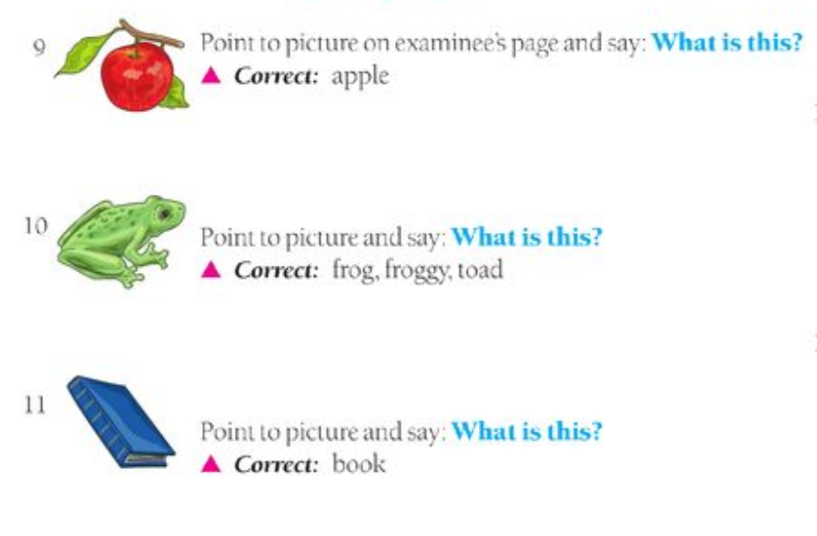
Expressive Vocabulary:
Woodcock Munoz Language Survey-III

Slide 16
Observations: Select Questions
When delivering instruction,how do teachers take into consideration the varying needs of students with different language learner profiles (e.g., native speakers, second language learners, new arrivals, students who are already bilingual in English and the partner language)?
How do teachers integrate language and content instruction?
Does instruction in one language builds on concepts learned in the other language?
How does instruction leverage students’ bilingualism by strategically incorporating cross-linguistic strategies?
Does instruction promote an awareness of language variation? If so, how?
Note: This set of observations will be informed by teacher input; they are not ‘assessing’ instruction, they seek to identify strong features of biliteracy and bilingual instruction.

Slide 17
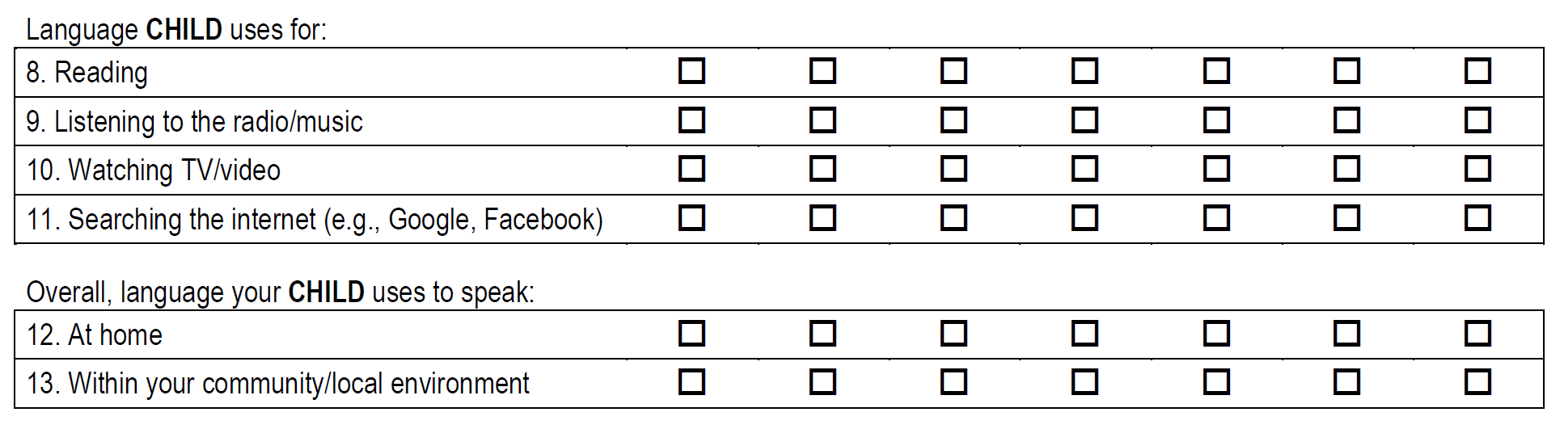
Parent Questionnaire:
Example Items

Slide 18
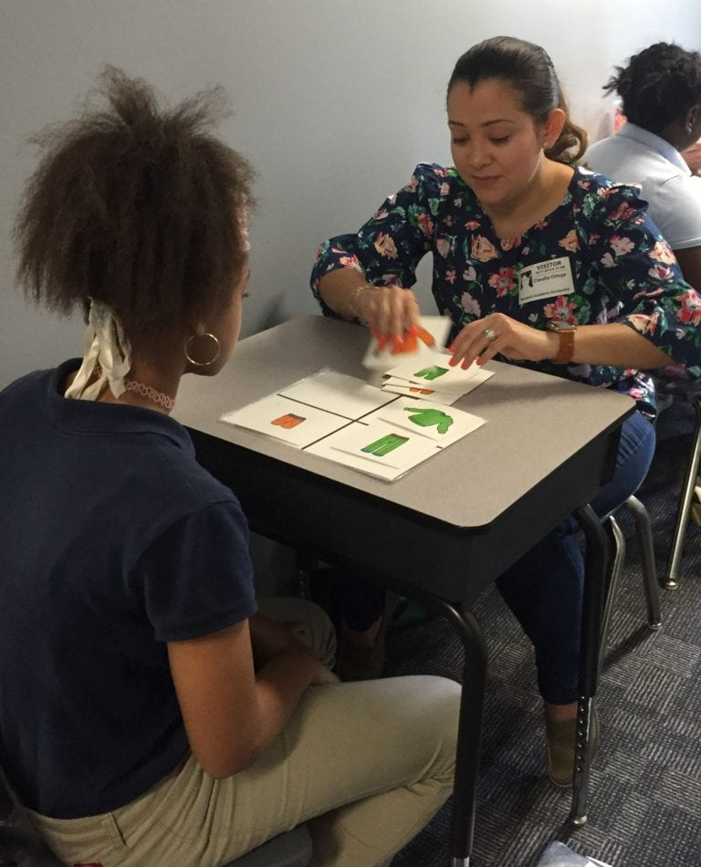
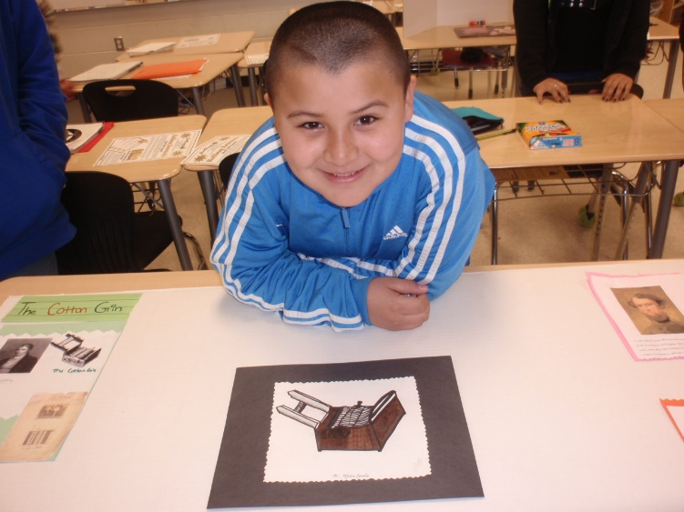
Questions? Thank you!
For More Information
Ana Taboada Barber, Ph.D.
ataboada@umd.edu
(301) 405-6482
Department of Counseling, Higher Education, and Special Education
University of Maryland, College Park

